Slide 1
National Cancer Patient Experience Survey
2025 communications toolkit for fieldwork period
November 2025 to February 2026

Slide 2
Contents
About this toolkit
Communications messaging
Communications assets
Frequently asked questions

Slide 3
About this toolkit
What is this toolkit?
This toolkit is designed to help with the communication and promotion of the 2025 National Cancer Patient Experience Survey (NCPES) during the fieldwork period (10 November 2025 to 30 January 2026).
The aim of the toolkit is to raise awareness of the survey amongst patients who will be eligible to complete the 2025 survey.
All communication materials are available to download at www.ncpes.co.uk/promoting-the-survey.
Why is it important to promote the survey?
Additional promotion of the survey can help encourage people to take part if they have been invited. It is important that as many people as possible respond to the survey so that the results reflect the views of cancer patients.
Patients who will be eligible are all adult patients (aged 16 and over), with a confirmed primary diagnosis of cancer, who have been admitted to hospital as inpatients for cancer related treatment, or who were seen as day case patients for cancer related treatment, and have been discharged during the months of April, May or June 2025. For trusts taking part in the 2025 pilot to test the use of text message reminders, patients discharged in March may also be eligible for the survey.
Eligible patients will be sent letters to invite them to take part in the survey. A letter will be sent out around 10 November 2025, with two reminders shared around 8 December 2025 and 12 January 2026. For trusts taking part in the 2025 pilot, text message reminders will also be sent to participants after each paper mailing.
Notes:
For those aged 16 and under, feedback is collected via the Under 16 Cancer Patient Experience Survey.
The National Cancer Patient Experience Survey is a separate survey from the Cancer Quality of Life Survey.

Slide 4
How to use this toolkit
Who can I share the toolkit with?
This toolkit can be shared with different teams who may be in contact with eligible cancer patients during the fieldwork period (10 November 2025 to 30 January 2026).
If you work in a trust, you could get in touch with your engagement/comms teams or cancer alliance to see how they can support with promoting the survey.
Please also consider sharing this toolkit or messaging within the toolkit with your colleagues in patient facing roles. For example:
How should the toolkit be used?
To reach these audiences effectively, it is likely that most communication will be carried out by NHS trusts who are providing treatment to eligible patients.
Please consider different touchpoints with patients, for example if you share communications with patients via an app, face-to-face or letters, there are different resources in this toolkit that can be used and adapted for these purposes. The materials can be used online or printed (in colour or greyscale).
This toolkit is a guide and it's understood that you will adapt the content as needed to best communicate with different audiences. Please ensure you do not change the core messaging.
Patient engagement or experience teams
Macmillan Information Centre
Communications teams
Departments that interact with eligible patients during this period (e.g., radiology, haematology, surgical, diagnostic)
Local cancer support groups and charities

Slide 5
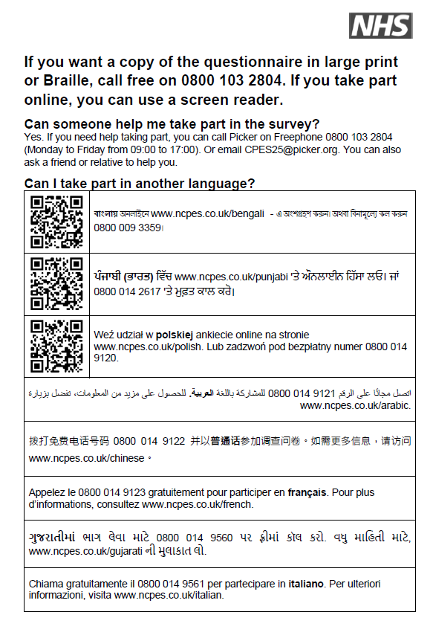
How to use this toolkit
How can the toolkit help to encourage underrepresented groups to complete the survey?
We would encourage you to look at groups that are underrepresented in your results locally and try to target communications accordingly.
Consider sharing the toolkit or messaging with local community groups or charities that represent the groups you’re trying to reach.
The communications assets such as posters and social media cards have been designed for a variety of audiences, please choose the assets that are most appropriate for the groups you are trying to reach.
If possible, please encourage healthcare professionals to mention the survey when speaking to patients. Some feedback we have received is that patients are much more likely to take note of the survey if it is spoken about by their healthcare professional.
The survey can be completed via telephone in over 20 languages. It is also available online in Polish, Bengali and Punjabi. The survey is also available in large print or Braille on request. The translation and accessible formats are signposted to participants using the ‘accessibility sheet’ shown on this slide which is included in the first and third mailing.

Slide 6
How to use this toolkit
Promotion of the survey is important at several points within the survey cycle, particularly for the sampling period, fieldwork and publication.
 | 2025 |  |  |  |  |  |  |  |  |  | 2026
 | March | April | May | June | July | Aug | Sep | Oct | Nov | Dec | Jan | Feb | March | April | May | June | July | Aug
Survey cycle |  | Sampling period – when patients eligible for the survey are having cancer treatment |  |  |  |  |  |  | Fieldwork – survey are sent to eligible patients (3 mailings) |  |  |  |  |  |  |  | Publication and webinar
Comms | Sampling toolkit shared | Promotion during sampling period |  |  |  |  |  | Fieldwork toolkit shared | Promotion during fieldwork |  |  |  |  |  |  |  | Promotion of results

Slide 7
Communications messaging

Slide 8
About the NCPES
This summary can be used to describe the National Cancer Patient Experience Survey and its purpose. Below is a short and longer version depending on the content / channel you are applying it to.
Short summary
The NHS wants to make sure patients have a good experience of care. Getting feedback from patients helps us improve and give patients what they need. The National Cancer Patient Experience Survey (NCPES) asks cancer patients (16 years and older) about their experiences of care. Their feedback helps us to improve cancer services across England. If a patient received treatment for cancer in the hospital as an inpatient or day-case and left hospital between April and June 2025, they may be invited to take part in the survey. For more details about the survey, visit www.ncpes.co.uk.
Longer summary
The NHS wants to make sure patients have a good experience of care. Getting feedback from patients helps us improve and give patients what they need.
The National Cancer Patient Experience Survey (NCPES) asks cancer patients (16 years and older) about their experiences of care. Their feedback helps us to improve cancer services across England. If a patient received treatment for cancer in the hospital as an inpatient or day-case and left hospital between April and June 2025, they may be invited to take part in the survey.
The NHS and cancer charities use the results to find out what is working well and what needs to improve. National and local NHS teams can then work with patients to make changes.
The 2025 survey will start in November 2025 and the results will be available in Summer 2026. For more information, visit www.ncpes.co.uk.

Slide 9
Key messages
Primary key message:
It is important for the NHS to know how patients feel about their care and treatment.
The National Cancer Patient Experience Survey (NCPES) helps improve care for adults (16 years and older) who are being treated for cancer.
You may get other surveys about your cancer care, but we hope you will also take part in the NCPES. Your feedback will help the NHS make cancer care better.
If you are invited, please take part in the NCPES. We need as many people as possible to take part so the results reflect the views of different cancer patients.
Secondary key messages:
The National Cancer Patient Experience Survey (NCPES) collects feedback from cancer patients. This helps us to improve cancer services across England.
The NHS and cancer charities use the results to find out what is working well and what needs to improve. National and local NHS teams can then work with patients to make changes.

Slide 10
Newsletter copy
Please consider using the following newsletter copy in your bulletins or newsletters that are shared with patients.
​Title:
National Cancer Patient Experience Survey​
Copy:
The NHS wants to make sure patients have a good experience of care. Getting feedback from patients helps us improve and give patients what they need.
The National Cancer Patient Experience Survey (NCPES) asks cancer patients (16 years and older) about their experiences of care. Their feedback helps us to improve cancer services across England.
If you had treatment for cancer in the hospital as an inpatient or day-case and left hospital between April and June 2025, you may be invited to take part in the survey.
If you are invited, you will get a letter with more information. Please take part and share your experiences of cancer care. You may get other surveys about your cancer care, but we hope you will also take part in the NCPES. Your answers will help the NHS make cancer care better.
The survey takes around 20 minutes. You can take part online, on paper, or over the phone. If you need help or want to take part in another language, you can call the Freephone helpline at 0800 103 2804.
The NHS and cancer charities use the results to find out what is working well and what needs to improve. National and local NHS teams can then work with patients to make changes.
The survey is anonymous. Your personal data will be kept safe.
For more information, visit www.ncpes.co.uk.

Slide 11
Website / blog copy
This website / blog copy has been developed for use on webpages and can be adapted for your local audience with inclusion of local case studies. You can use the promotional quote cards alongside this copy.
The NHS wants to make sure patients have a good experience of care. Getting feedback from patients helps us improve and give patients what they need.
The National Cancer Patient Experience Survey (NCPES) asks cancer patients (16 years and older) about their experiences of care. Their feedback helps us to improve cancer services across England.
If you had treatment for cancer in the hospital as an inpatient or day-case and left hospital between April and June 2025, you may be invited to take part in the survey. If you are invited, you will get a letter with more information. Please take part and share your experiences of cancer care.
You may get other surveys about your cancer care, but we hope you will also take part in the NCPES. Your answers will help the NHS make cancer care better.
The NHS and cancer charities use the results to find out what is working well and what needs to improve. National and local NHS teams can then work with patients to make changes.
For more information, visit www.ncpes.co.uk.

Slide 12
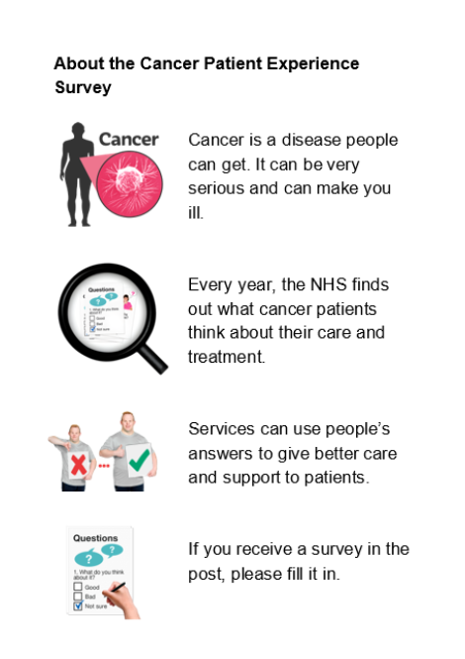
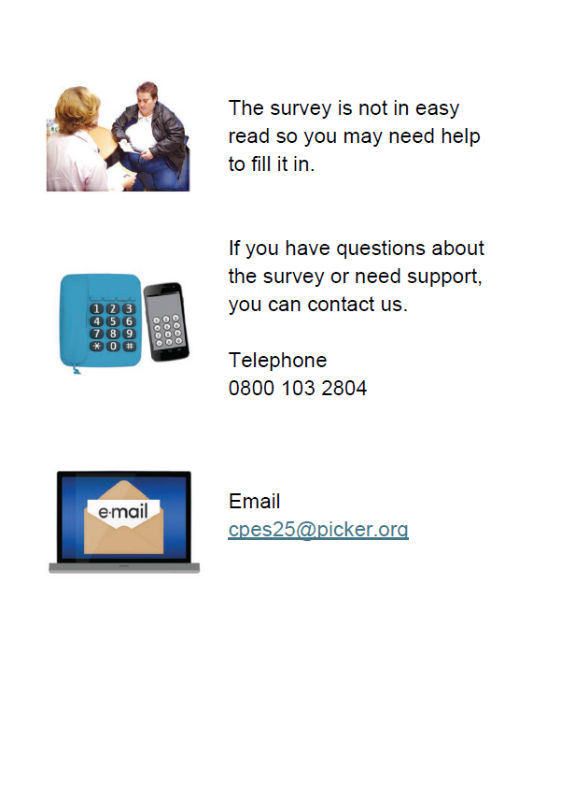
Easy read messaging
This easy read information can be shared to encourage completion of the survey. The information can be downloaded here.

Slide 13
Internal comms
Please consider sharing this messaging with your colleagues internally to help with promotion of the survey. This could be shared on your staff intranet or internal newsletters.
Please help with promotion of the Cancer Patient Experience Survey
The National Cancer Patient Experience Survey (NCPES) is designed to help improve the experience and quality of care for adults (16 years and over) being treated for cancer.
Patients who are being invited to take part in the 2025 survey are all adult patients (aged 16 and over), with a confirmed primary diagnosis of cancer, who have been admitted to hospital as inpatients for cancer related treatment, or who were seen as day case patients for cancer related treatment, and were discharged during the months of April, May or June 2025.
Additional promotion of the survey can help encourage people to take part when they have been invited. It is important that as many people as possible respond to the survey so that the results reflect the views of cancer patients
Please use the resources in this communications toolkit to promote the survey. The communications toolkit includes a script for NHS staff to use when speaking to patients. Some feedback we have received from patient representatives is that patients are much more likely to take note of the survey if it is spoken about by their healthcare professional.
For more information visit www.ncpes.co.uk
​

Slide 14
Script when talking to patients
This script has been developed for NHS staff to use when speaking to patients. Some feedback we have received from patient representatives is that patients are much more likely to take note of the survey if it is spoken about by their healthcare professional.
Patient feedback is really important in helping us to deliver what patients want and need.
As you were treated for cancer and discharged between April and June 2025, you may receive the National Cancer Patient Experience Survey (NCPES) through the post in November. The survey will ask you about your experience of cancer care.
The NHS and cancer charities use the results to understand what is working well and what needs to improve.
If you are invited, please take part and share your experiences of care. Your answers will help the NHS make cancer care better.
Note for NHS staff on eligibility of cancer patients for the NCPES 2025:
Patients who will be invited to take part in the 2025 survey are all adult patients (aged 16 and over), with a confirmed primary diagnosis of cancer, who have been admitted to hospital as inpatients for cancer related treatment, or who were seen as day case patients for cancer related treatment, and have been discharged during the months of April, May or June 2025. For trusts taking part in the 2025 pilot to test the use of text message reminders, patients discharged in March may also be eligible for the survey.
Not all cancer patients will be invited as some exclusion criteria is applied to the sampling. For example, we exclude private patients, anyone known to be a current inpatient, patients solely treated as an outpatient, and patients without a UK postal address.
For more information on the survey, please visit www.ncpes.co.uk.

Slide 15
Social media copy
Over the following pages you will find suggested copy for:
Bluesky / X (formerly Twitter)
Facebook
Instagram stories
Instagram post
Alongside the wording provided, you can share assets provided in this toolkit, for example:
Social media cards
Promotional quote cards
Improvement work posters
Infographics
Latest results
Videos
Please always tag @NHSEngland and when relevant for the channel use the hashtag #CancerPatientExperienceSurvey.

Slide 16
Bluesky / X (formerly Twitter)
Posts for the beginning of the fieldwork period (November 2025):
If you are being treated for cancer during April, May, June 2025, you may be invited to take part in the National Cancer Patient Experience Survey. If invited, have your say in the #CancerPatientExperienceSurvey 📢 www.ncpes.co.uk @NHSEngland
It’s important for the NHS to know how patients feel about their care. It helps us improve cancer services. If you are invited to take part, have your say in the #CancerPatientExperienceSurvey 📢 www.ncpes.co.uk @NHSEngland
The NHS want to understand the experiences of patients. This helps us provide better cancer care. If you are invited to take part in the #CancerPatientExperienceSurvey, have your say 📢 www.ncpes.co.uk @NHSEngland
Last year, patients in the #CancerPatientExperienceSurvey rated their overall care 8.94 out of 10 on average. If invited, have your say in the #CancerPatientExperienceSurvey 📢 www.ncpes.co.uk @NHSEngland
In last year’s #CancerPatientExperienceSurvey, 90.4% of patients said the whole care team worked well together. If invited, have your say in the #CancerPatientExperienceSurvey 📢 www.ncpes.co.uk @NHSEngland
Posts to remind people to take part at the end of the fieldwork period (January 2025):
Don’t miss your chance to help inform positive change to cancer services 🤝. If invited, have your say in the #CancerPatientExperienceSurvey www.ncpes.co.uk @NHSEngland
Final reminder ⏰ help contribute to future improvements in your local cancer services. If you are invited to take part in the #CancerPatientExperienceSurvey, have your say www.ncpes.co.uk @NHSEngland

Slide 17
Facebook
Posts for the beginning of the fieldwork period (November 2025):
At the NHS, we want to make sure patients have a good experience of care. Getting feedback from patients helps us improve and give patients what they need.
If you were treated for cancer during April, May, June 2025, you may be invited to take part in the National Cancer Patient Experience Survey. If you are invited, you will get a letter with more information.
Please have your say 📢 Your answers will help the NHS make cancer care better.
For more information on the survey, please visit www.ncpes.co.uk
Understanding our patients' experiences of care is important to us. It helps us improve our services to best suit their needs.
If you were treated for cancer during April, May, June 2025, you may be invited to take part in the National Cancer Patient Experience Survey. If you are invited, you will get a letter with more information. Please take part to help shape NHS services for future patients 🤝
For more information on the survey, please visit www.ncpes.co.uk
Posts to remind people to take part at the end of the fieldwork period (January 2026):
Don’t miss your chance to help inform positive change to cancer services. The National Cancer Patient Experience Survey was sent out to those who are eligible, and will be closing soon ⏰.
​If you were invited, please don’t miss the opportunity to take part and share your experiences of care. ​The NHS and cancer charities use the results to understand what is working well and which areas need improvement.
The survey has been posted to those eligible to complete. For more information on the survey and how to access help and support in completing it, please visit www.ncpes.co.uk

Slide 18
Instagram
Instagram stories (use images with text overlaid)
Story one – Were you treated for cancer in April, May or June 2025? (if possible include swipe up link to www.ncpes.co.uk/faq)
Story two - Has something or someone supported you through your cancer treatment? Or is there something you wish you were being offered? (if possible include swipe up link to www.ncpes.co.uk/faq)
Story three - The #CancerPatientExperienceSurvey helps us improve local cancer services and outcomes for people affected by cancer. (if possible include swipe up link to www.ncpes.co.uk/faq)
Story four - If you’re invited to take part, please have your say. Your answers will help the NHS make cancer care better.
Click the link for more information. (if possible include swipe up link to www.ncpes.co.uk/faq)
Instagram post
Were you treated for cancer in April, May or June 2025? Is there something you think the NHS should continue doing or improve on? Last year, patients in the #CancerPatientExperienceSurvey rated their overall care 8.94 out of 10 on average. If you’re invited to take part in the #CancerPatientExperienceSurvey please have your say. Your answers will help the NHS make cancer care better.
The NHS want to understand the experiences of patients. This helps us provide better cancer care.
If you are invited, you will get a letter with more information. Visit the survey website (link in bio) for more information.

Slide 19
Communications assets

Slide 20









Social media cards
These social media cards can be shared alongside social media posts. Social media cards can be downloaded here.

Slide 21


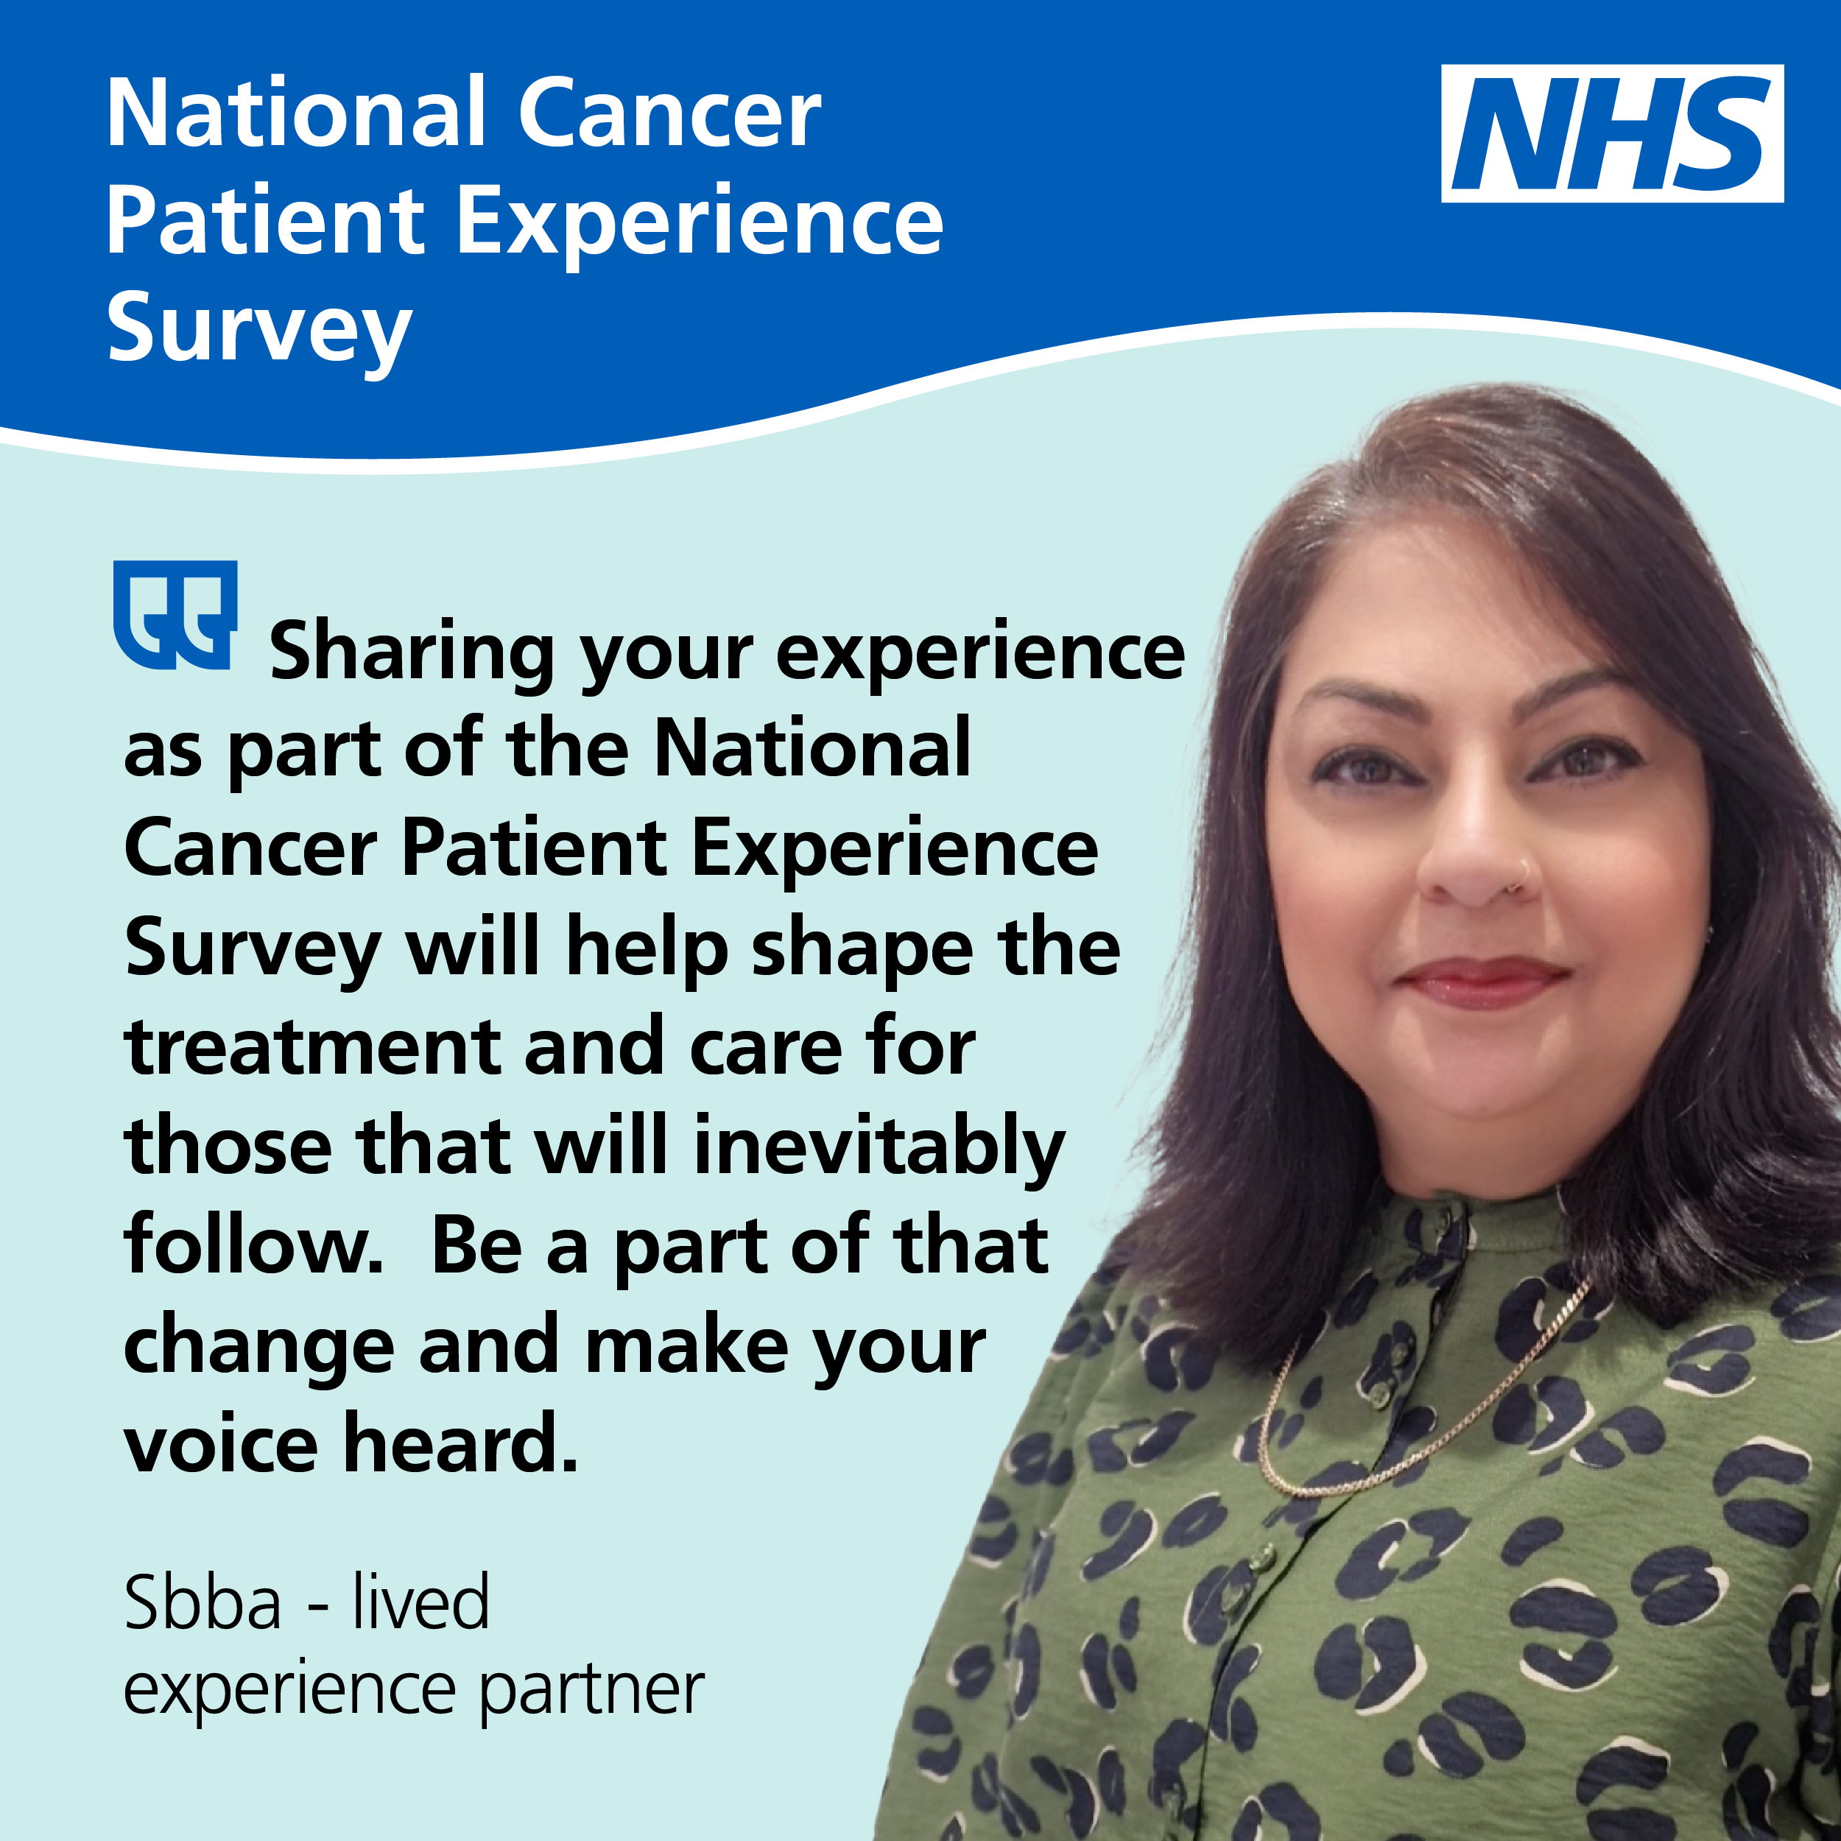



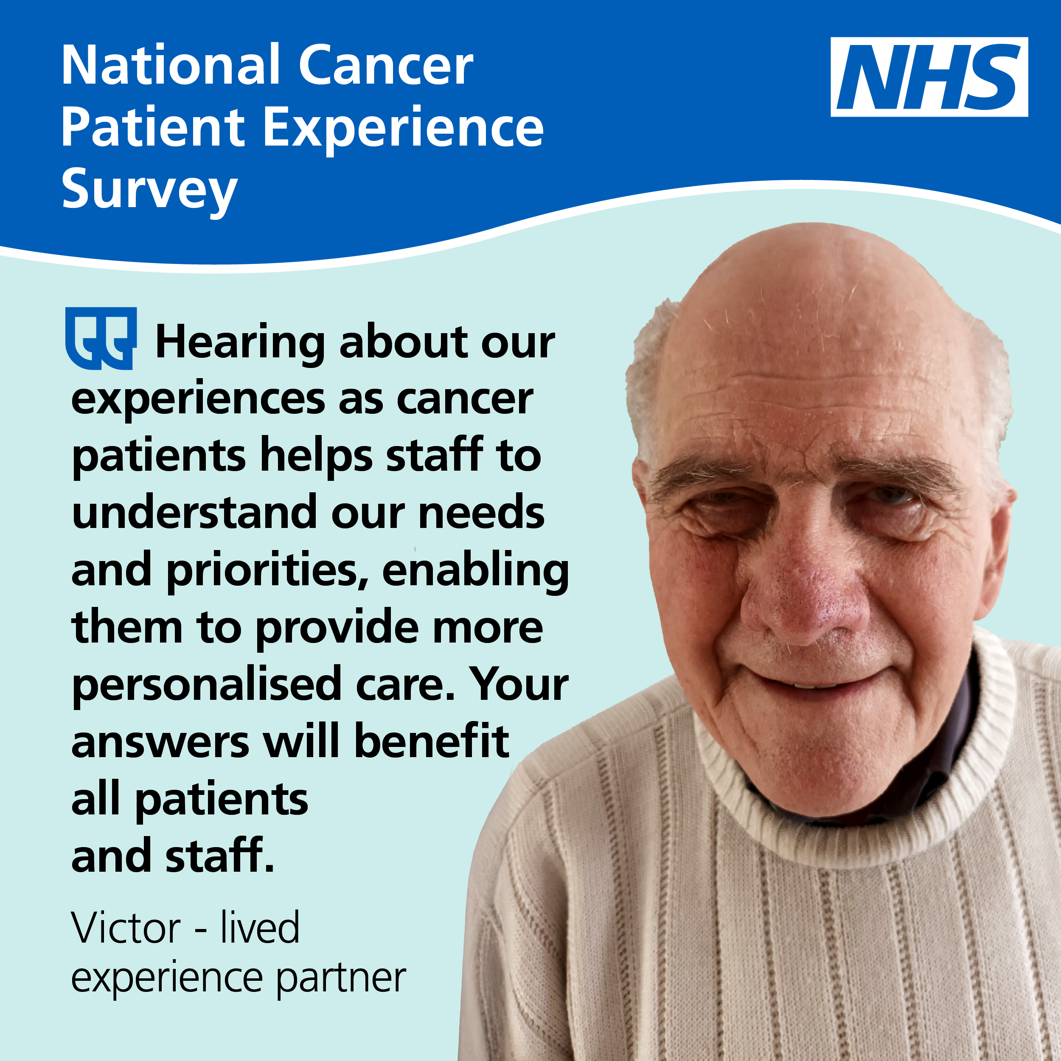

Promotional quote cards: Patient representatives
These quote cards have been produced by cancer patients and patient representatives. In their own words, they talk about why NCPES is important. The quote cards can be shared alongside social media posts. The cards can be downloaded here.
The individuals have given permission for their quote cards to be used to promote the survey.

Slide 22


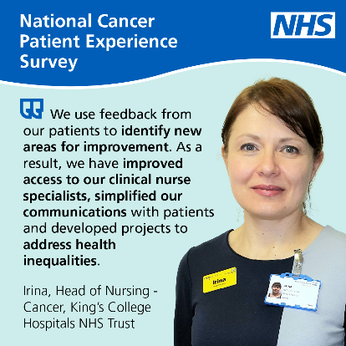
Promotional quote cards: NHS
These promotional quote cards can be shared alongside social media posts. The cards can be downloaded here.
These quote cards have been produced by those who use the survey data. In their own words, they talk about why NCPES is important.
The individuals have given permission for their quote cards to be used to promote the survey.

Slide 23

Promotional quote cards: Template
A blank quote card has also been provided so you can add quotes and photos from your local area. This could be from patients or NHS staff.
If developing quote cards internally, please ensure you have the required permissions from the individual providing an image or quote.

Slide 24








Posters
Please consider displaying these posters in areas that are visible to people affected by cancer and their friends or family. You can print them in colour or greyscale. You can also display them online, for example on your website, social media or TV screens in waiting areas. Posters can be downloaded here.

Slide 25
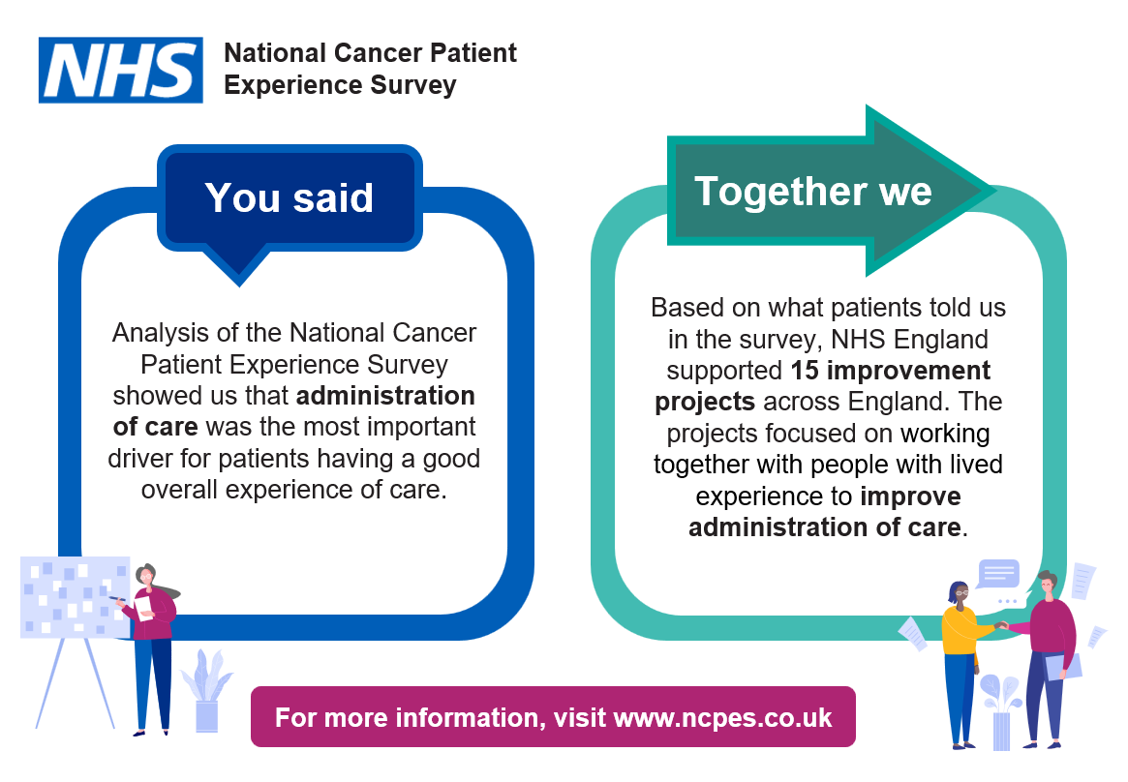
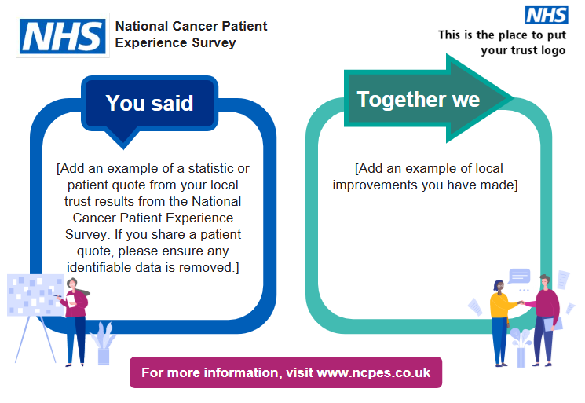
Improvement work posters
There is a national improvement work poster which can be displayed. There is also a template for you to add examples of local improvement work to demonstrate the impact of the survey. We encourage you to populate the local template where possible. The poster template and guidance can be downloaded here.
We often hear from patients that demonstrating the value of NCPES is key. Patients want to know how their feedback has been used. The improvement work posters can be used to encourage participation in future surveys.

Slide 26

Banner or email signature
This banner can be used to promote the survey. It can be used for different purposes such as on your website, your local app, in your email signature or on printed letters sent to patients.
The banner can be downloaded here.

Slide 27
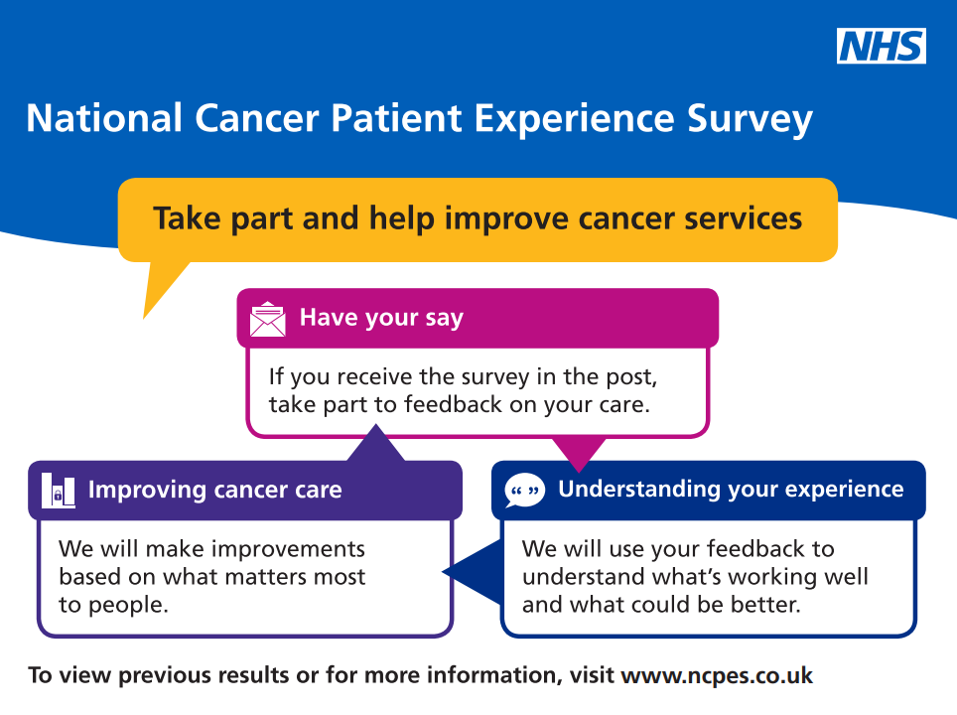
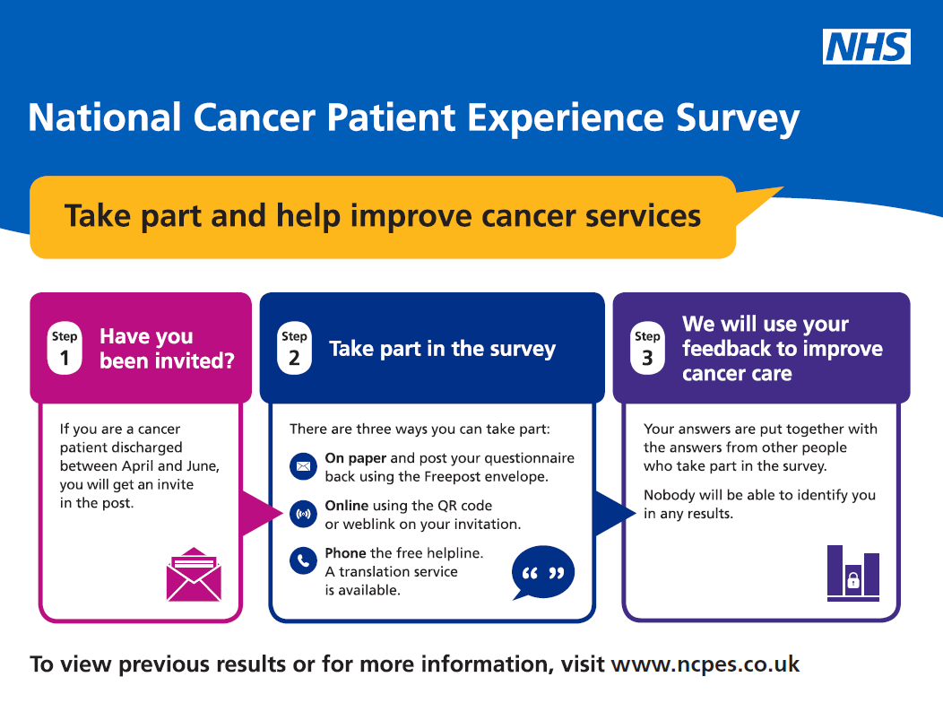
Infographics
These infographics are designed to explain the purpose and process of NCPES. The files can be downloaded from here.

Slide 28
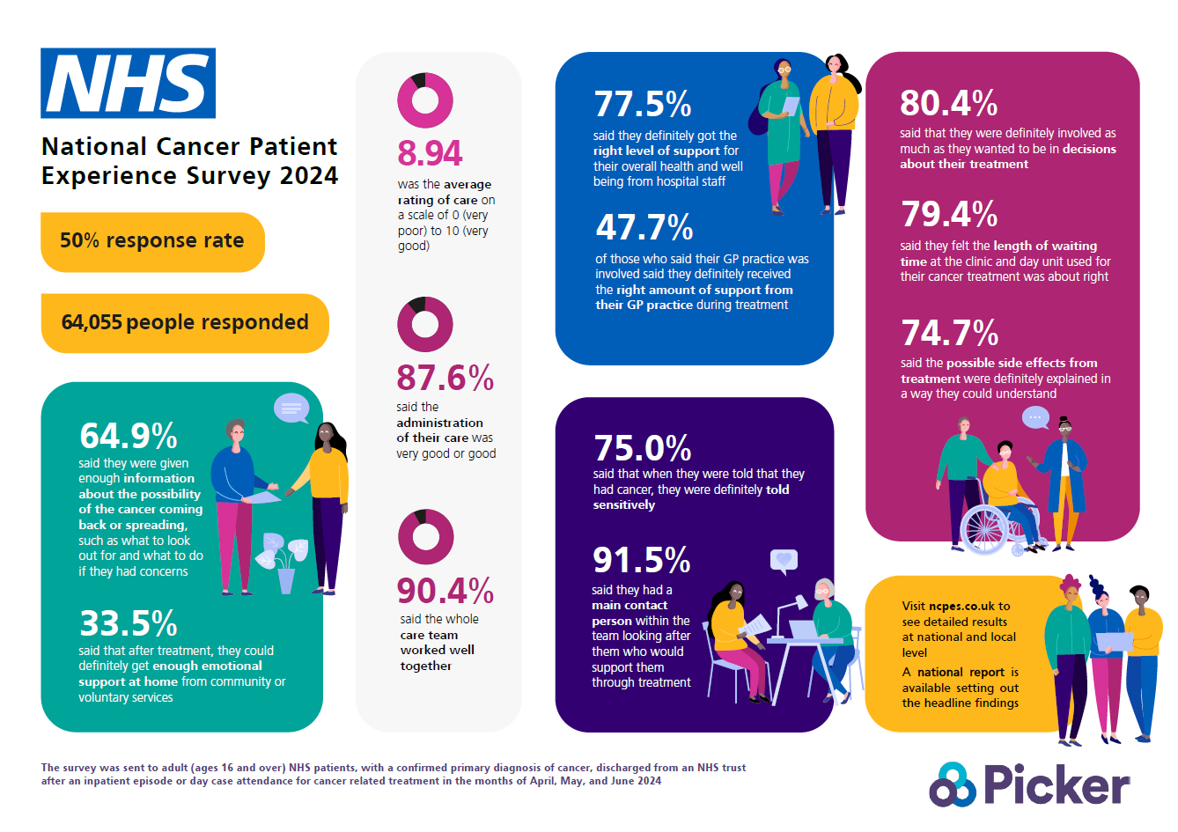
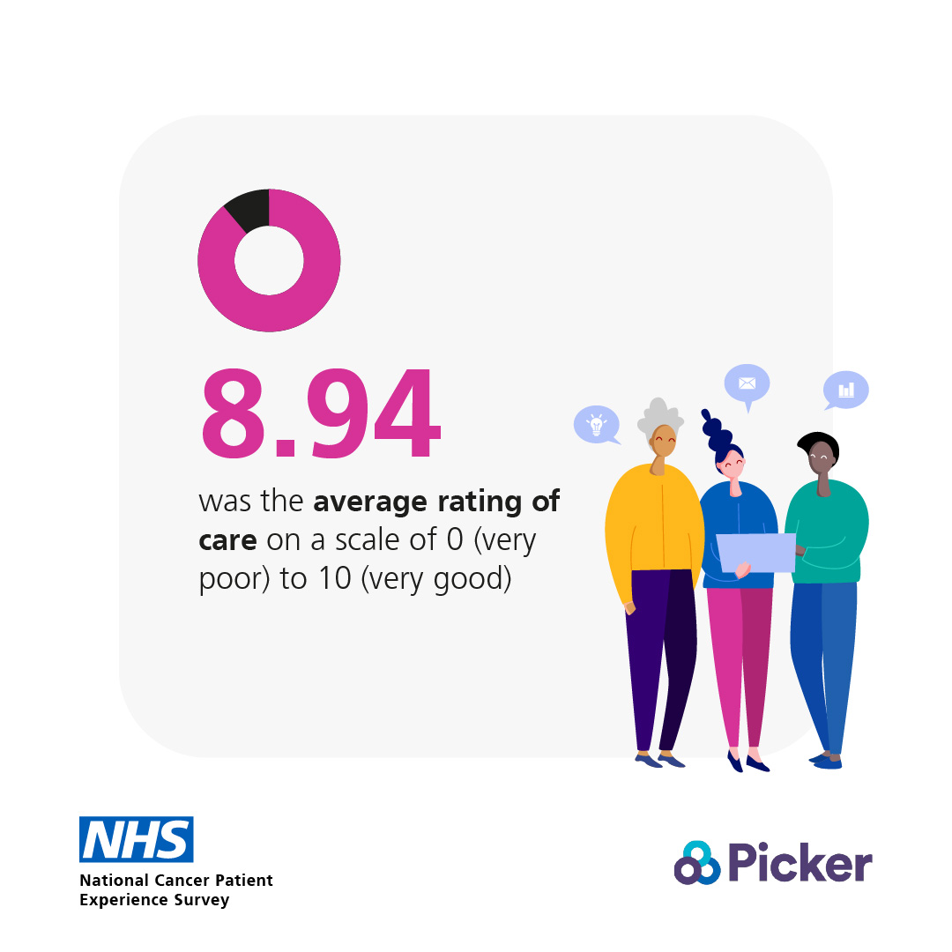
Latest results
There are national results infographic and social cards that show a summary of the 2024 results and an infographic template and social media card template are available for you to add your local results, which can be used to encourage patients to complete this year’s survey. The files can be downloaded here.
Results infographic:
Example of social card:

Slide 29
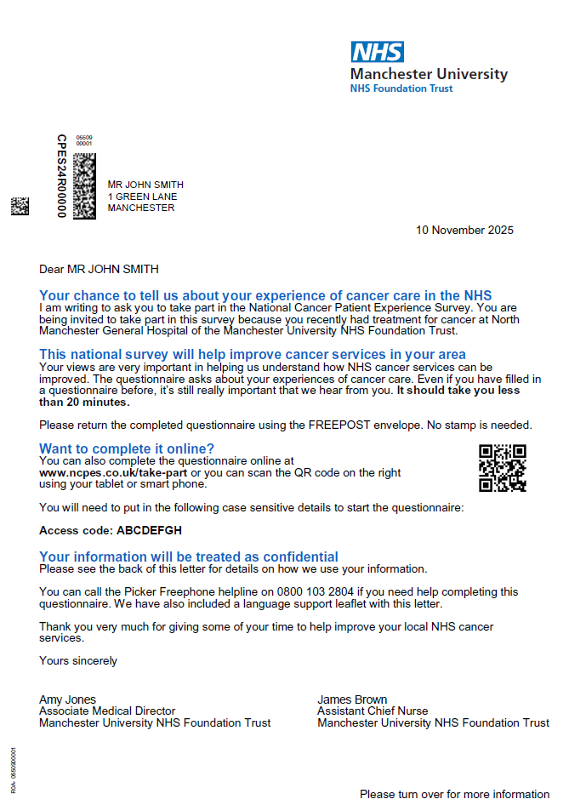
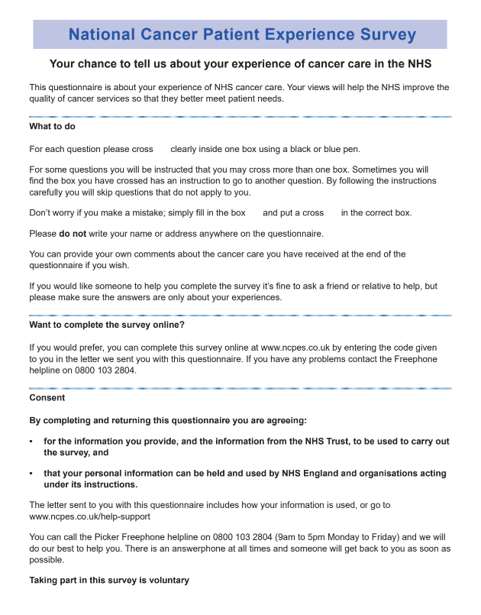
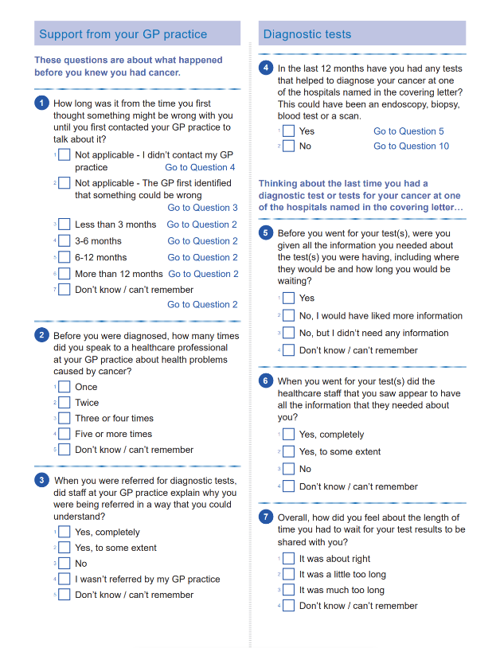
Examples of the letters and survey
These images show examples of the letter and survey that eligible patients will receive through the post. The images can be downloaded here.
These images can be used to help familiarise patients with what the survey looks like and that the survey is genuine and sent from the NHS.

Slide 30

Impact of the survey - Cancer Experience of Care Improvement Collaborative (CIC)
NCPES results are used as part of the Cancer Experience of Care Improvement Collaborative (CIC). The CIC brings together groups of cancer healthcare professionals and people with lived experience from different organisations to improve services.
The aim of the CIC is for each project team to use insight and feedback (like National Cancer Patient Experience Survey results) to improve the experience of care for cancer patients and their friends and family who may provide unpaid care and support. Project teams are able to make improvements based on what matters to people who use cancer services that align with local, regional, and national priorities.
Further information on the Cancer Experience of Care Improvement Collaborative can be found here.
The videos on the page can be used to promote the impact of NCPES and why Project Teams have got involved in the CIC.

Slide 31
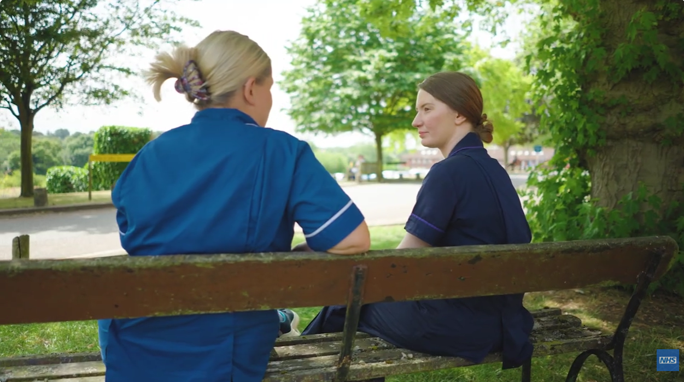
Cancer Experience of Care Improvement Collaborative (CIC) Case Study Video
This video can be shared to demonstrate the impact of the NCPES and the Cancer Experience of Care Improvement Collaborative.
The Cancer Experience of Care Improvement Collaborative is a coaching and quality improvement framework which brings together organisations and people with lived experience to improve experiences for people affected by cancer.
For the 2023-2024 collaborative the NCPES data, alongside other insight, was used to decide the focus on learning disabilities, autism, mental health and dementia.
As part of this collaborative, Sherwood Forest NHS Foundation Trust and University Hospitals of Leicester came together to look at the urgent suspected cancer pathway for people with a learning disability. The team created a digital flagging system and are now able to identify pathway lengths for patients with and without additional needs.
Their next steps include involving specialist teams for early support, developing reasonable adjustment offers, and creating resource packs to support different groups of patients.
The video is on YouTube and is available here.

Slide 32
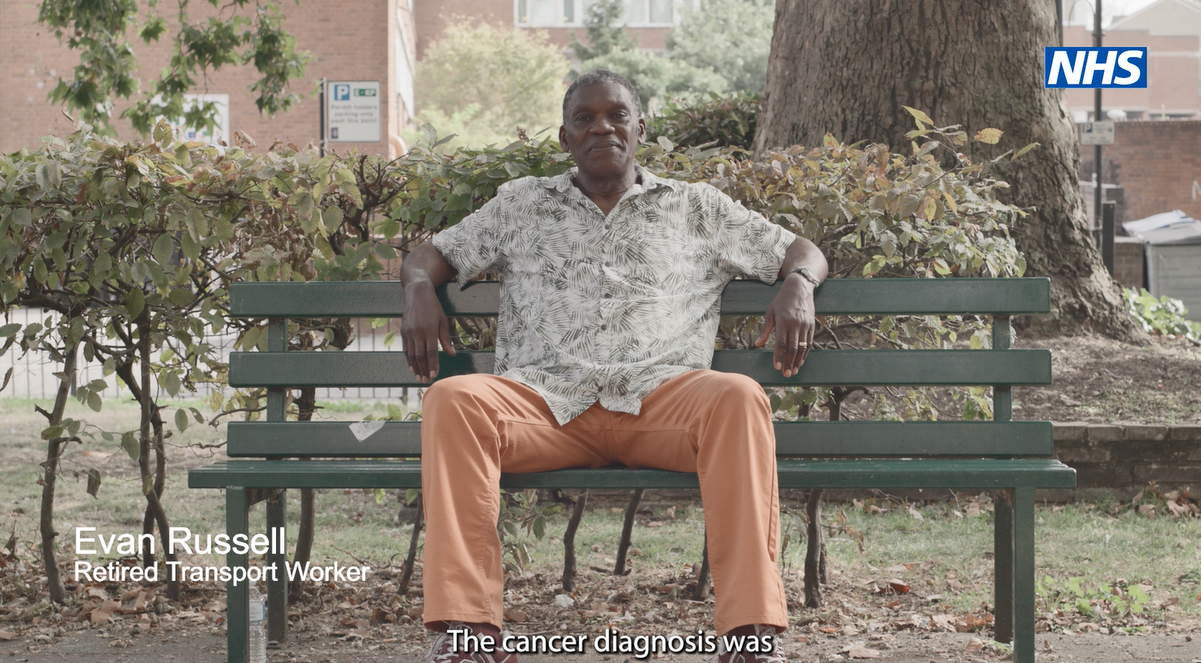
Case study video
National Cancer Patient Experience Survey - Improving Support for Black Men with Prostate Cancer
Guy’s and St Thomas’ NHS Foundation Trust and South East London Cancer Alliance carried out an improvement project based on the results of the National Cancer Patient Experience Survey (NCPES) which has identified needs for improved support for black men with prostate cancer.
We have created this video to support the uptake of the NCPES survey and to encourage patients who are often underrepresented in NCPES to take part.
The aims of the case study videos are to:
Demonstrate the impact of the NCPES and how the results are used to make improvements to cancer services.
Encourage seldom heard groups to complete the NCPES.
The full version of the video is on YouTube and is available here.
Social media video clips are available here.

Slide 33
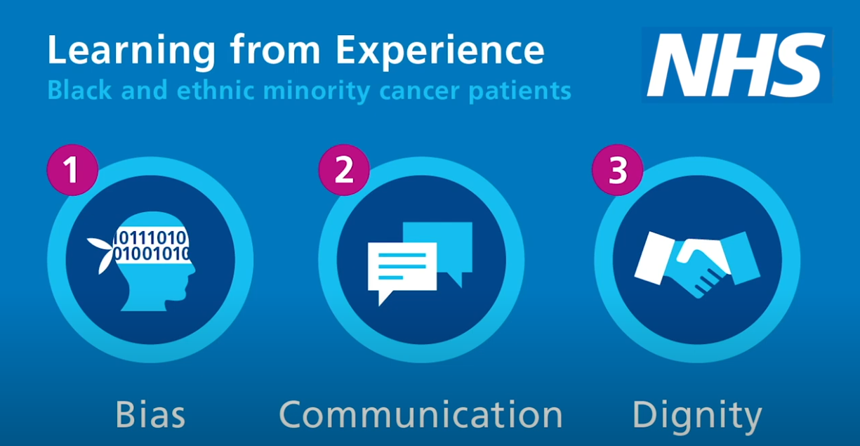
Videos
Learning from experience – black and ethnic minority cancer patients
Three short films were developed by NHS England, in response to data from the NCPES, which showed ethnically diverse patients consistently report a poorer experience than white British people who take part in the survey.
The films examine three themes – bias, communication and dignity. They highlight the importance of involving and listening to people from different communities within the NCPES.
Learning from the experience of BME cancer patients – Bias
Learning from the experience of BME cancer patients – Communication
Learning from the experience of BME cancer patients – Dignity

Slide 34
Frequently Asked Questions

Slide 35
FAQs
Q. What is the purpose of the survey?
A. The purpose of collecting and analysing data via this survey is to:
To measure continuous improvement and enable local systems to assess their performance improvement with other providers and commissioners.
Provide NHS England with an up-to-date overview of cancer patient experience across England.
The survey results are used to understand patient experience and to improve cancer services across England. The results will be looked at to understand differences in people’s experiences, for example, to see if people answer differently depending on their ethnic group or their type of cancer. This will help to identify where improvements are most needed and for which groups, communities, or populations.
Q. Who is running the survey?
A. Picker Institute Europe is carrying out the survey on behalf of NHS England. For more information on Picker, visit www.picker.org.
Q. How can I find out more about the survey?
A. You can find more information about the survey, including previous survey results, at www.ncpes.co.uk.
Q. When will survey results be available?
A. Reports will be available in Summer 2026 at www.ncpes.co.uk.
Q. Who will be included in the survey?
A. The survey will cover all acute and specialist NHS Trusts in England that provide adult acute cancer services. The survey will include all adult patients (aged 16 and over), with a primary diagnosis of cancer, who have been admitted to hospital as inpatients for cancer related treatment, or who were seen as day case patients for cancer related treatment and have been discharged between 1 April 2025 and 30 June 2025. For trusts taking part in the 2025 pilot to test the use of text message reminders, patients discharged in March may also be eligible for the survey.

Slide 36
FAQs
Q. I have received a questionnaire but need help completing it
A. There is a freephone helpline number: 0800 103 2804 for the survey where you can get help completing it or to request translation services to complete the questionnaire. Information is also available on the back of the cover letter that was sent to you with the questionnaire, and online at www.ncpes.co.uk/faq/
Q. Why can’t I (patient) take part in the survey?
A. The survey is only offered to adult patients (aged 16 and over) with a confirmed diagnosis of cancer who have been admitted to hospital as inpatients for cancer related treatment, or who were seen as day case patient for cancer related treatment and have been discharged between the months of April, May or June 2025.
Patients aged 16 and under will be invited to take part in the Under 16 Cancer Patient Experience Survey, please visit www.under16cancerexperiencesurvey.co.uk
Q. Do I have to take part?
A. No, if you do not want to take part, please return the blank questionnaire. You do not need to use a stamp. If you prefer, please email Picker (cpes24@picker.org) or call the helpline number (0800 103 2804) and Picker will remove you from the current survey mailing list.
Q. Should I take part if I have previously completed a survey?
A. Yes, you can still take part in this survey. There may be other surveys which ask about the experiences of cancer patients, but we would be grateful to hear your feedback in the 2025 National Cancer Patient Experience Survey.

Slide 37
FAQs
Q. How else can I provide feedback if I am not invited to take part?
A. Feedback can be provided through the Patient Advice and Liaison Service (PALS) or patient services manager for the NHS trust where you received care.
Specific complaints can also be made through the NHS trust where you received your care. Each NHS trust has a member of staff responsible for complaints who will try to resolve the matter with you.
If you would prefer to give anonymous feedback, you could ask staff at the hospital for information about how to give feedback using the Friends and Family Test (FFT). The FFT is designed to be a quick and easy way to give anonymous feedback that will go directly to the staff providing your care.
For more information about making a complaint to the NHS please visit: How to make a complaint to the NHS.

Slide 38
Thank you
If you have any questions, please contact: england.insight-queries@nhs.net

