Slide 1
NCPES infographic instructions
This file contains two template infographics which you can populate with results for your trust, ICB or alliance when results are published, allowing you to share your headline findings more widely.
You can:
Add your trust, ICB or alliance logo to the top right. Simply delete the template logo that is there and add your own.
Edit the template text provided in each bubble. Click on the text and start typing.
Update the ring charts seen in the first infographic (instructions on the next slide).
The images and the coloured spaces for text cannot be updated.
Font used in this infographic
This infographic is set up to use the font Arial.
The default font size for percentages is 18.
The default font size for question text is 12.

Slide 2
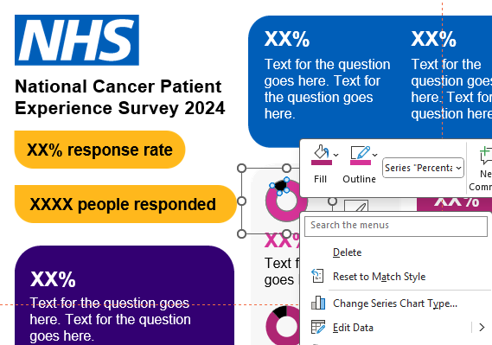
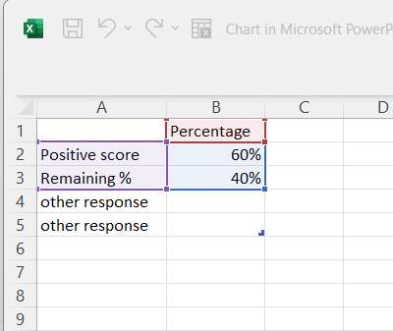
NCPES infographic instructions
Ring charts
One of the infographics has two ring charts that can be updated.
By right clicking on each and selecting ‘Edit Data’ you can update the percentages to the results for the questions you’d like to include.

Slide 3
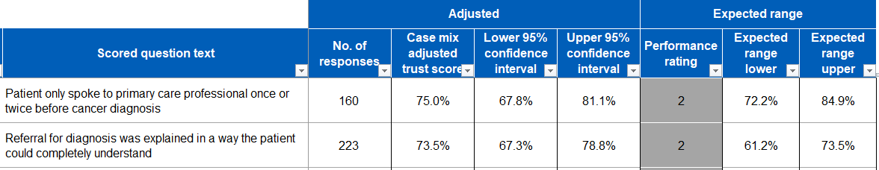
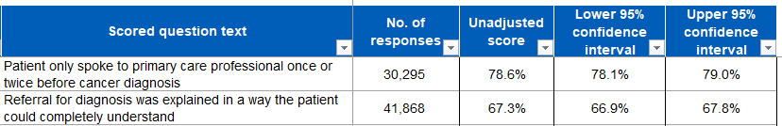
NCPES infographic instructions
Presentation of results
NCPES uses both adjusted and unadjusted scores.
Adjusted scores allow for fair comparisons to be made between different organisations as these scores are adjusted to take into account the proportion of patients within five sub-groups: age, ethnicity, ‘which of the following best describes you?’, cancer type, and area-level deprivation (IMD quintile). Adjusted scores, together with expected ranges, should be used to understand whether the results for a specific organisation are significantly higher or lower than national results taking account of their patient population. If you intend to make such comparisons in your infographic, please use the case mix adjusted scores in your report.
Unadjusted scores should not be used to make comparisons. They should be used to see the actual responses from patients relating to the organisation and also to track trends over time. If you intend to reference results for your trust only, please use the unadjusted scores in your report.

Slide 4

NCPES infographic instructions
Presentation of results
When populating your infographic, we recommend you use a similar question statement style to that seen in the national infographic.
For example, the style used for Q28 and Q51 is as follows:

Slide 5
NCPES infographic instructions
Printing off your infographic
The slide size of this template is set to A4 paper, allowing you to print off and share your infographics as posters. You can check this by going to Design > Slide Size > Custom Slide size in the menu/ribbon above.
Get in touch
For more information about the survey visit www.ncpes.co.uk
If you have any questions, please contact cpes@pickereurope.ac.uk

Slide 6

XX%
XX%
Text for the question goes here. Text for the question goes here.
Text for the question goes here. Text for the question here.
XX% response rate
XXXX people responded
XX%
XX%
Text for the question goes here. Text for the question goes here.
Text for the question goes here. Text for the question goes here.
XX%
Text for the question goes here.
XX%
Text for the question goes here. Text for the question goes here.
XX%
XX%
Text for the question goes here. Text for the question goes here.
Text for the question goes here. Text for the question goes here. Text for the question goes here. Text for the question goes here.
XX%
XX%
Text for the question goes here. Text for the question goes here.
Text for the question goes here.
XX%
Text for the question goes here. Text for the question goes here.
This box can be used for information about the trust.
XX%
Text for the question goes here.

Slide 7
XX%
XX%
Text for the question goes here. Text for the question goes here.
Text for the question goes here. Text for the question here.
XX% response rate
XXXX people responded
XX%
XX%
Text for the question goes here. Text for the question goes here. Text for the question goes here.
Text for the question goes here. Text for the question goes here.
XX%
Text for the question goes here. Text for the question goes here.
XX%
Text for the question goes here. Text for the question goes here. Text for the question goes here.
XX%
Text for the question goes here. Text for the question goes here. Text for the question goes here
XX%
Text for the question goes here. Text for the question goes here.
XX%
Text for the question goes here. Text for the question goes here. Text for the question goes here. Text for the question goes here.
This box can be used for information about the trust.

