Slide 1
Cancer Patient Experience Survey (CPES)
2023 communications toolkit
This toolkit is designed to help with the communication and promotion of the 2023 CPES in order to raise awareness of the survey and encourage patients to participate. This toolkit is a guide and it's understood that you will adapt the content as needed to best communicate with different audiences. Please ensure you do not change the core messaging.
If you have any questions about the toolkit please contact england.cancercomms@nhs.net

Slide 2
Contents
About CPES
Key Messages
Visual guidelines
Icons
Video
Website copy
Newsletter copy
Blog copy
Social media content
Twitter
Facebook
Instagram
10. Infographic
11. Poster
12. FAQs

Slide 3
About CPES
This summary can be used to describe the CPES and its purpose. Below is a short and longer version depending on the content / channel you are applying it to.
Short summary
At the NHS, we want our patients to have the best experience possible and having continuous patient feedback is crucial in helping us to deliver what patients want and need. The national Cancer Patient Experience Survey (CPES) asks for feedback from cancer patients (16 years and over*), to inform and improve local cancer services across England. Those who were treated for cancer as an inpatient or day-case, and left hospital in April, May or June 2023, will be invited to take part in the survey. For more information on the survey and how to access help and support in completing it, please visit www.ncpes.co.uk.
*For those aged 16 and under, feedback is collected via the Under 16 Cancer Patient Experience Survey: www.under16cancerexperiencesurvey.co.uk.
Longer summary
At the NHS, we want our patients to have the best experience possible and having continuous patient feedback is crucial in helping us to deliver what patients want and need.
The national Cancer Patient Experience Survey (CPES) asks for feedback from cancer patients (16 years and over*), to inform and improve local cancer services across England. Those who were treated for cancer as an inpatient or day-case, and left hospital in April, May or June 2023, will be invited to take part in the survey.
The NHS and cancer charities use the results to understand what is working well and which areas need improvement. The results enable them to identify national and local priorities and work with patients and partners to deliver change.
The 2023 CPES fieldwork will begin in autumn 2023, with results available next year.
For more information on the survey and how to access help and support in completing it, please visit www.ncpes.co.uk.
*For those aged 16 and under, feedback is collected via the Under 16 Cancer Patient Experience Survey: www.under16cancerexperiencesurvey.co.uk.

Slide 4
Key messages
Primary key message:
Understanding the experiences of care and treatment is extremely important to the NHS.
The national Cancer Patient Experience Survey (CPES) is designed to help improve the experience and quality of care for adults (16 years and over) being treated for cancer.
By completing CPES cancer patients inform positive change and continuous improvement of NHS cancer services.
Secondary key messages:
The Cancer Patient Experience Survey (CPES) asks for feedback from cancer patients to monitor cancer services nationally and to inform improvements to local cancer services across England.
The NHS and cancer charities use the CPES results to understand what is working well and which areas need improvement. The results enable them to identify national and local priorities and work with patients and partners to deliver service changes.

Slide 5
Visual Guidelines
When communicating about CPES we request all visual elements comply with the NHS technical guidelines. ​
​
To keep the look and feel of CPES consistent within the NHS visual guidelines we request you use the following colour pallet when producing any visual items.
NHS Blue
Pantone: 300 CMYK: 99/50/0/0 RGB: 0/94/184 #005EB8 RAL: 5017
White
CMYK: 0/0/0/0 RGB: 255/255/255 #FFFFFF
NHS Dark Blue
Pantone: 287 CMYK: 100/75/2/18 RGB: 0/48/135 #003087
NHS Green
Pantone: 355 CMYK: 91/0/100/0 RGB: 0/150/57 #009639
NHS Warm Yellow
Pantone: 1235 CMYK: 0/31/98/0 RGB: 255/184/28 #FFB81C
Dark Pink
Pantone: 683 CMYK: 26/99/12/50 RGB: 124/40/85 #7C2855

Slide 6
Icons
These icons can be used when communicating about the Cancer Patient Experience Survey (CPES) and should be used to help patients digest and understand information we’re communicating.
These icons can be downloaded from here.
Survey being filled out – via phone
Survey being filled out - computer
Survey received by post.
Survey being filled out - written.
Survey being filled out - mobile
Analysis of results.
Positive changes being made to NHS services as a result.

Slide 7
Video
National Cancer Patient Experience Survey - Improving Support for Black Men with Prostate Cancer
Guy’s and St Thomas’ NHS Foundation Trust and South East London Cancer Alliance have carried out an improvement project based on the results of the Cancer Patient Experience Survey (CPES) which has identified needs for improved support for black men with prostate cancer.
We have created this video to support the uptake of the 2023 Adult CPES survey and to encourage patients who are often underrepresented in CPES to take part.
The aims of the case study videos are to:
Demonstrate the impact of the CPES and how the results are used to make improvements to cancer services.
Encourage seldom heard groups to complete the CPES.
The full version of the video is on YouTube and is available here.
Social cuts for social media promotion will be available shortly here.

Slide 8
Website copy
Please consider using the following web copy on your website:
Title – National Cancer Patient Experience Survey
Copy - At the NHS, we want our patients to have the best experience possible and having continuous patient feedback is crucial in helping us deliver what patients want and need.
The national Cancer Patient Experience Survey (CPES) asks for feedback from cancer patients (16 years and over*), to inform and improve local cancer services across England. Those who were treated for cancer as an inpatient or day-case, and left hospital in April, May or June 2023, will be invited to take part in the survey.
The survey takes no more than 20 minutes to complete and can be done online, on paper, or over the phone. If you need support completing the survey or need it made available in another language, you can call the free helpline number: 0800 103 2804.
The NHS and cancer charities use the results to understand what is working well and which areas need improvement. The results enable them to identify national and local priorities and work with patients and partners to deliver change.
The survey is anonymous, and all personal data will be kept safe.
The results of the survey will be available in Summer 2024.
For more information on the survey and how to access help and support in completing it, please visit www.ncpes.co.uk.
*For those aged 16 and under, feedback is collected via the Under 16 Cancer Patient Experience Survey: www.under16cancerexperiencesurvey.co.uk.
Web banner graphic. This can be downloaded here.

Slide 9
Newsletter copy
Newsletter copy can be used in public facing newsletters of shared with partner organisations that have agreed to help raise awareness of the survey
NHS organisation:
Cancer Patient Experience Survey 2023
We have launched our national Cancer Patient Experience Survey (CPES), asking for feedback from cancer patients (16 years and over*), to inform and improve local cancer services across England.
We want our patients to have the best experience possible and hearing about your experience is crucial in helping us deliver what you need and want.
The NHS and cancer charities use the results to understand what is working well and which areas need improvement. The results enable them to identify national and local priorities and work with patients and partners to deliver improvements.
Those who were treated for cancer as an inpatient or day-case, and left hospital in April, May or June 2023, will be invited to take part in the survey.
If you receive an invitation, please fill out the questionnaire and have your say so we can deliver the best possible service to patients. If you need support completing the survey or need it made available in another language. you can call the free helpline number 0800 103 2804.
For more information about the survey and other ways to provide feedback on cancer care please visit www.ncpes.co.uk.
*For those aged 16 and under, feedback is collected via the Under 16 Cancer Patient Experience Survey: www.under16cancerexperiencesurvey.co.uk.
Non-NHS organisation:
Cancer Patient Experience Survey 2023
NHS England has launched its national Cancer Patient Experience Survey (CPES), asking for feedback from cancer patients (16 years and over*), to inform and improve local cancer services across England.
The NHS want patients to have the best experience possible and hearing about your experience is crucial in helping them to deliver what you need and want.
The NHS and cancer charities use the results to understand what is working well and which areas need improvement. The results enable them to identify national and local priorities and work with patients and partners to deliver improvements.
Those who were treated for cancer as an inpatient or day-case, and left hospital in April, May or June 2023, will be invited to take part in the survey.
If you receive an invitation, please fill out the questionnaire and have your say so we can deliver the best possible service to patients. If you need support completing the survey or need it made available in another language. you can call the free helpline number: 0800 103 2804.
For more information about the survey and other ways to provide feedback on cancer care please visit www.ncpes.co.uk.
*For those aged 16 and under, feedback is collected via the Under 16 Cancer Patient Experience Survey: www.under16cancerexperiencesurvey.co.uk.

Slide 10
Blog copy
This blog has been developed for use on webpages and can be adapted for your local audience with inclusion of local case studies. If using the patient case study we’ve provided, please leave their wording unchanged.
At the NHS we want our patients to have the best experience possible and having continuous patient feedback is crucial in helping us deliver what patients want and need.
The national Cancer Patient Experience Survey (CPES) asks for feedback from cancer patients (16 years and over*), to inform and improve local cancer services across England. Those who were treated for cancer as an inpatient or day-case, and left hospital in April, May or June 2023, will be invited to take part in the survey.
The NHS and cancer charities use the results to understand what is working well and which areas need improvement. The results enable them to identify national and local priorities and work with patients and partners to deliver change.
If you are invited to take part, please fill out the questionnaire and have your say. Every response helps us to deliver the best possible service to patients.
If you need support completing the survey or need it made available in another language, you can call the helpline number for free: 0800 103 2804.
For more information on the survey please visit www.ncpes.co.uk.
*For those aged 16 and under, feedback is collected via the Under 16 Cancer Patient Experience Survey: www.under16cancerexperiencesurvey.co.uk.
“CPES gives us a chance to comment on the NHS service, to give praise where it is due, and to identify where things are not quite as we would wish. CPES is the tool that thousands of patients every year have used to improve our NHS and to improve care for the patients of the future, and the responses provide vast amounts of evidence for researchers looking for evidence as to what works best – for us, the patients.
“I’ve been able to help shape the survey, and I have seen how influential it can be, most obviously in shaping national policy. Since the Cancer Strategy of 2015, the NHS has been tasked with regarding Patient Experience as being just as important as clinical outcomes, and much of the evidence for that change came from CPES findings. Patients said loudly and clearly that what mattered was not just the cancer pathway and where that ended up, but the quality of our experience along our journey.”
Richard Stephens, patient representative on the CPES advisory group.

Slide 11
Social media content
Over the following pages you will find suggested copy and assets for:
Twitter
Facebook
Instagram stories
Instagram post
Please always tag @NHSEngland and when relevant for the channel use the hashtag #CancerPatientExperienceSurvey.
You can download all social assets here.

Slide 12
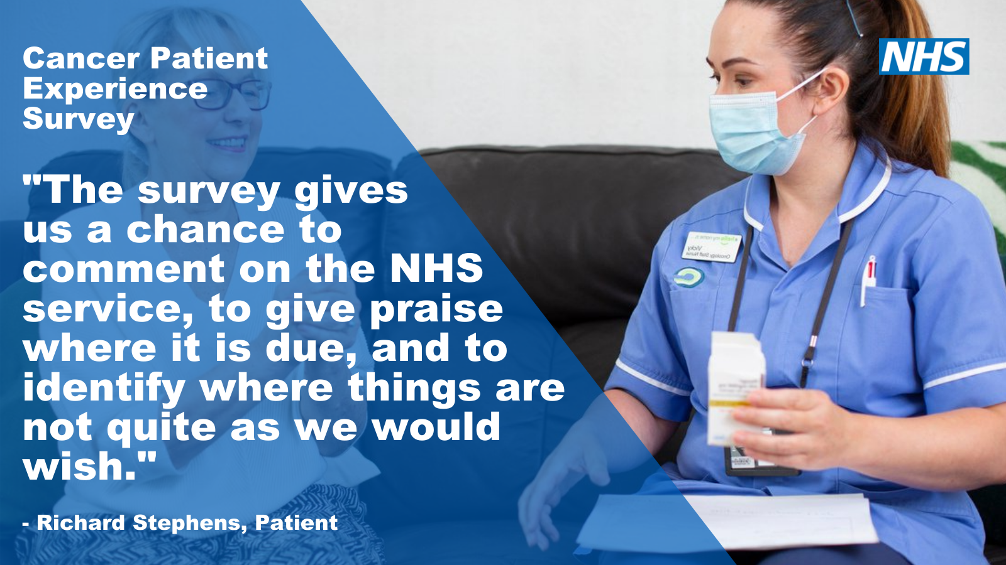
Twitter
At the NHS we want our patients to have the best experience possible and having continuous patient feedback is crucial in helping us deliver what patients want and need. If invited, have your say in the #CancerPatientExperienceSurvey www.ncpes.co.uk @NHSEngland
Understanding our patients’ experiences of care and treatment is extremely important to us as it helps us adapt our services to best suit their needs. If invited, have your say in the #CancerPatientExperienceSurvey www.ncpes.co.uk @NHSEngland
Our #CancerPatientExperienceSurvey gives a voice to patients to inform positive change and continuous improvement of our cancer services. If invited, have your say in the #CancerPatientExperienceSurvey www.ncpes.co.uk @NHSEngland
We want to listen & learn from our patients in order to improve the cancer care & support we provide. If you’ve received a questionnaire, please have your say in the #CancerPatientExperienceSurvey www.ncpes.co.uk @NHSEngland
To provide the best possible care for people diagnosed with cancer, it’s important for us to listen & learn from their experiences. The #CancerPatientExperienceSurvey informs how local cancer services are improved. If invited, have your say www.ncpes.co.uk @NHSEngland
Understanding the experiences of patients is essential for us to provide high quality personalised care and treatment. If you are invited to take part in the #CancerPatientExperienceSurvey, have your say www.ncpes.co.uk @NHSEngland
If you are invited to take part in the #CancerPatientExperienceSurvey, have your say and help contribute to future improvements in your local cancer services www.ncpes.co.uk @NHSEngland

Slide 13
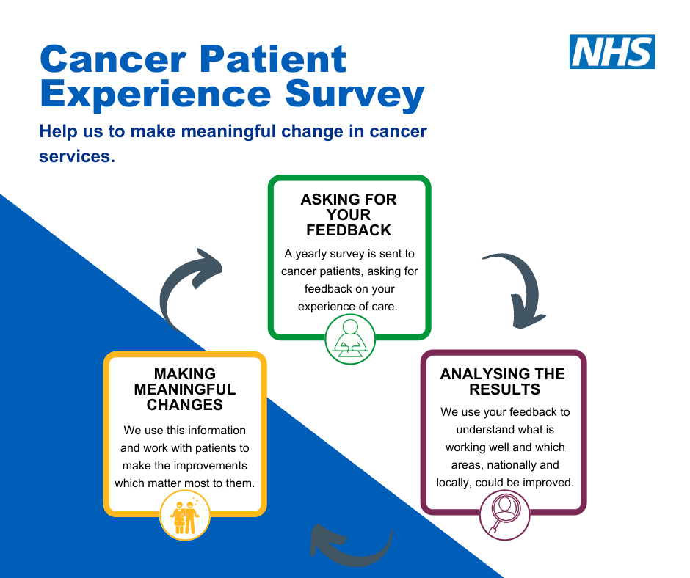
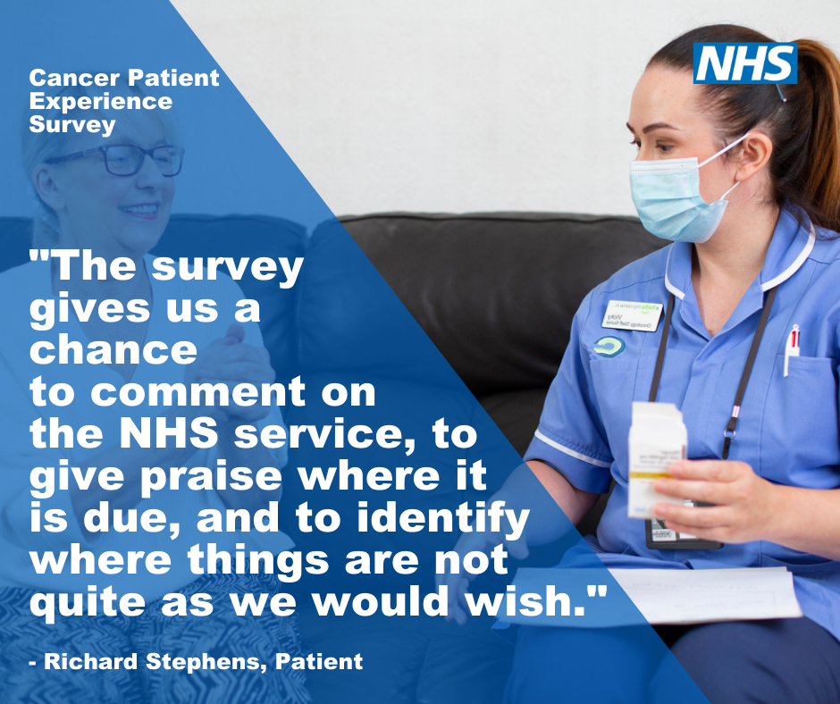
Facebook
We want to provide the best experience possible to cancer patients and having continuous feedback is crucial in helping us deliver what our patients want and need.
If you are invited to take part in the Cancer Patient Experience Survey, please have your say and help contribute to future improvements in your local cancer services.
The survey will be posted to those eligible to complete. For more information on the survey and how to access help and support in completing it please visit www.ncpes.co.uk
---
Understanding our patients' experiences of care and treatment is extremely important to us as it helps us adapt our services to best suit their needs. If invited, please take part in the Cancer Patient Experience Survey and help shape NHS services for future patients.
The survey will be posted to those eligible to complete. For more information on the survey and how to access help and support in completing it please visit www.ncpes.co.uk
Facebook banner
Facebook posts

Slide 14
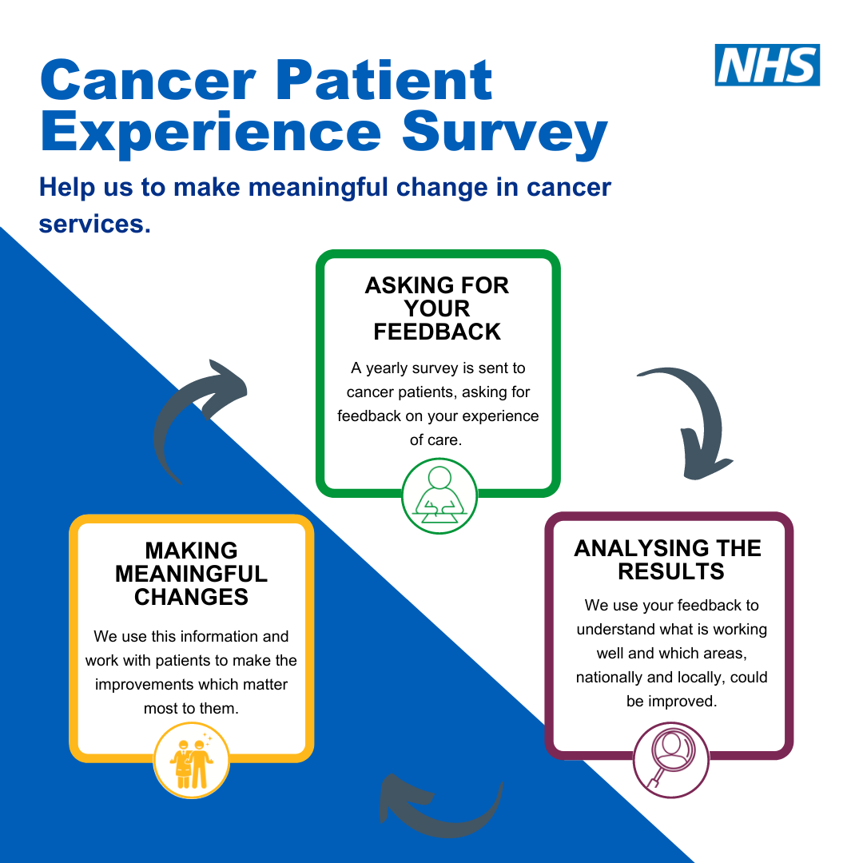
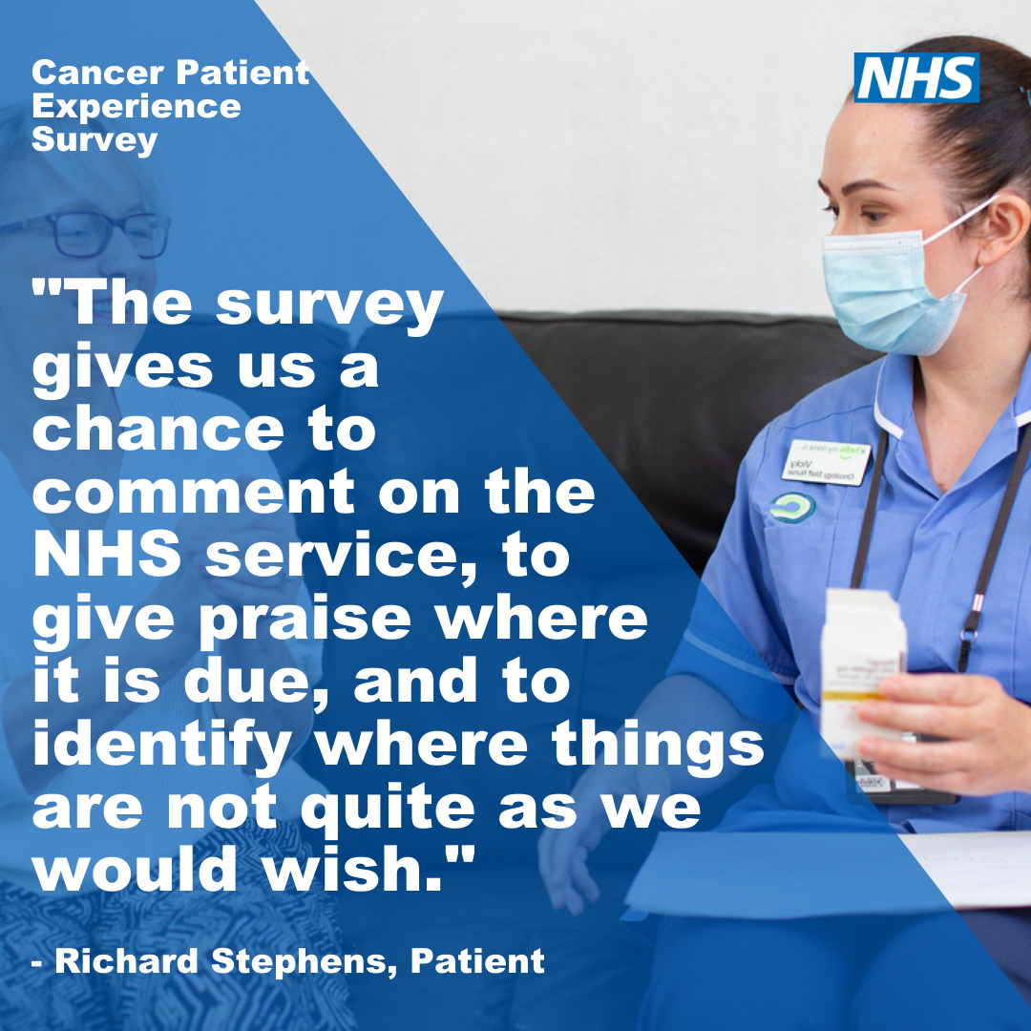
Instagram
Instagram is a great platform to communicate with young people. This is an age group which to date hasn’t been as engaged with the survey and we want to ensure more take part so that younger patient views (16+) are better represented in the survey results.
Instagram stories (use patient images with text overlaid)
Story one - Were you treated for cancer in April, May or June 2023? (if possible include swipe up link to www.ncpes.co.uk/faq)
Story two- Did something or someone really support you through your treatment, or is there something you wish you were offered looking back on your experience? (if possible include swipe up link to www.ncpes.co.uk/faq)
Story three - The #CancerPatientExperienceSurvey helps to inform improvements in local cancer services and outcomes for people affected by cancer. (if possible include swipe up link to www.ncpes.co.uk/faq)
Story four - If you’re invited to take part, please have your say and help contribute to future improvements in your local cancer services. Click the link for more information. (if possible include swipe up link to www.ncpes.co.uk/faq)
Instagram post
Were you treated for cancer in April, May or June 2023? Is there something you think the NHS should continue doing or improve on? If you’re invited to take part in the #CancerPatientExperienceSurvey please have your say and help contribute to future improvements in your local cancer services.
Understanding our patients' experiences of care and treatment is extremely important to us as it helps us adapt our services to best suit our patients' needs.
The survey will be posted to those who are eligible to take part. Visit the CPES website (link in bio) for more information.

Slide 15
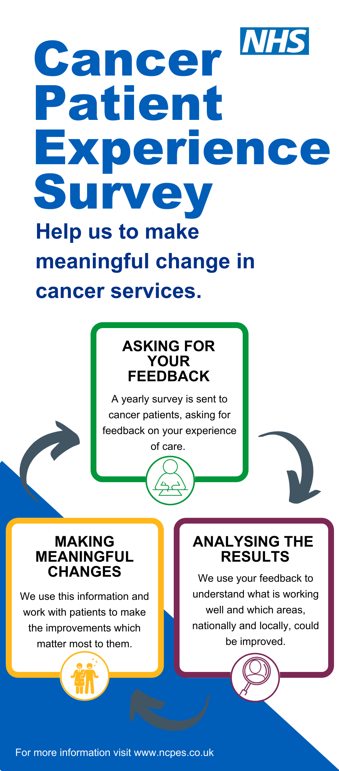
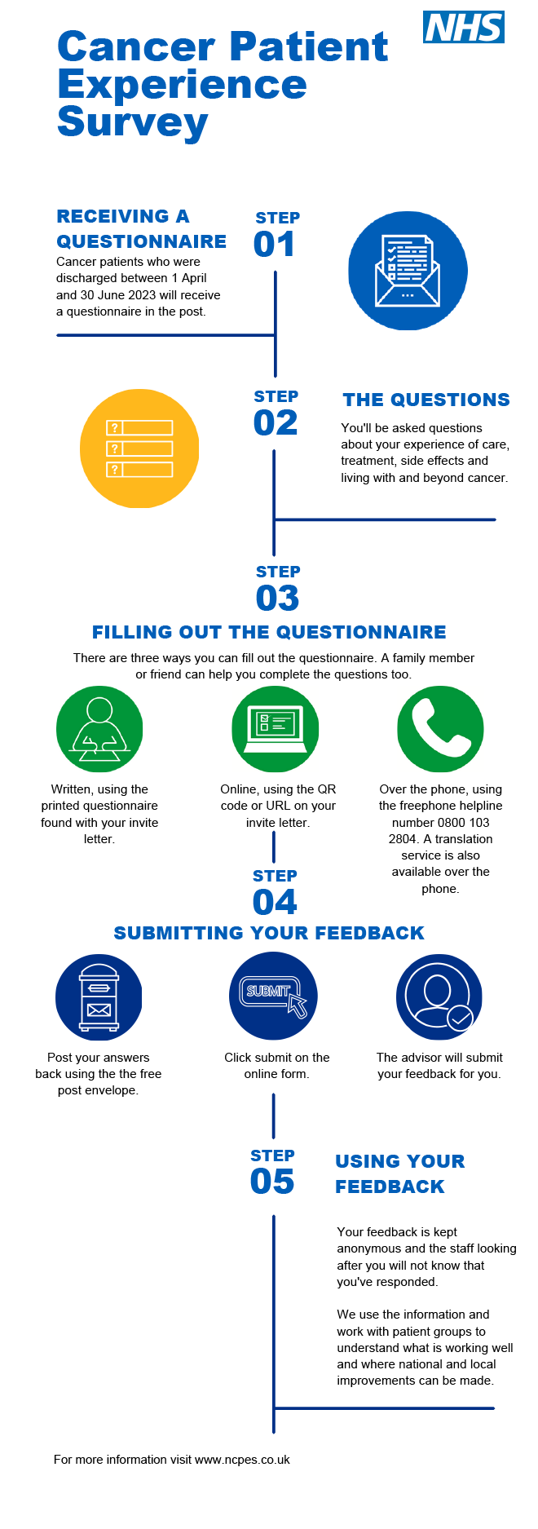
infographic
These infographics are designed to explain the purpose and process of CPES.
The file can be downloaded from here.
Graphic one - the process of CPES and how it informs change.
Graphic two – how to fill out the survey.

Slide 16
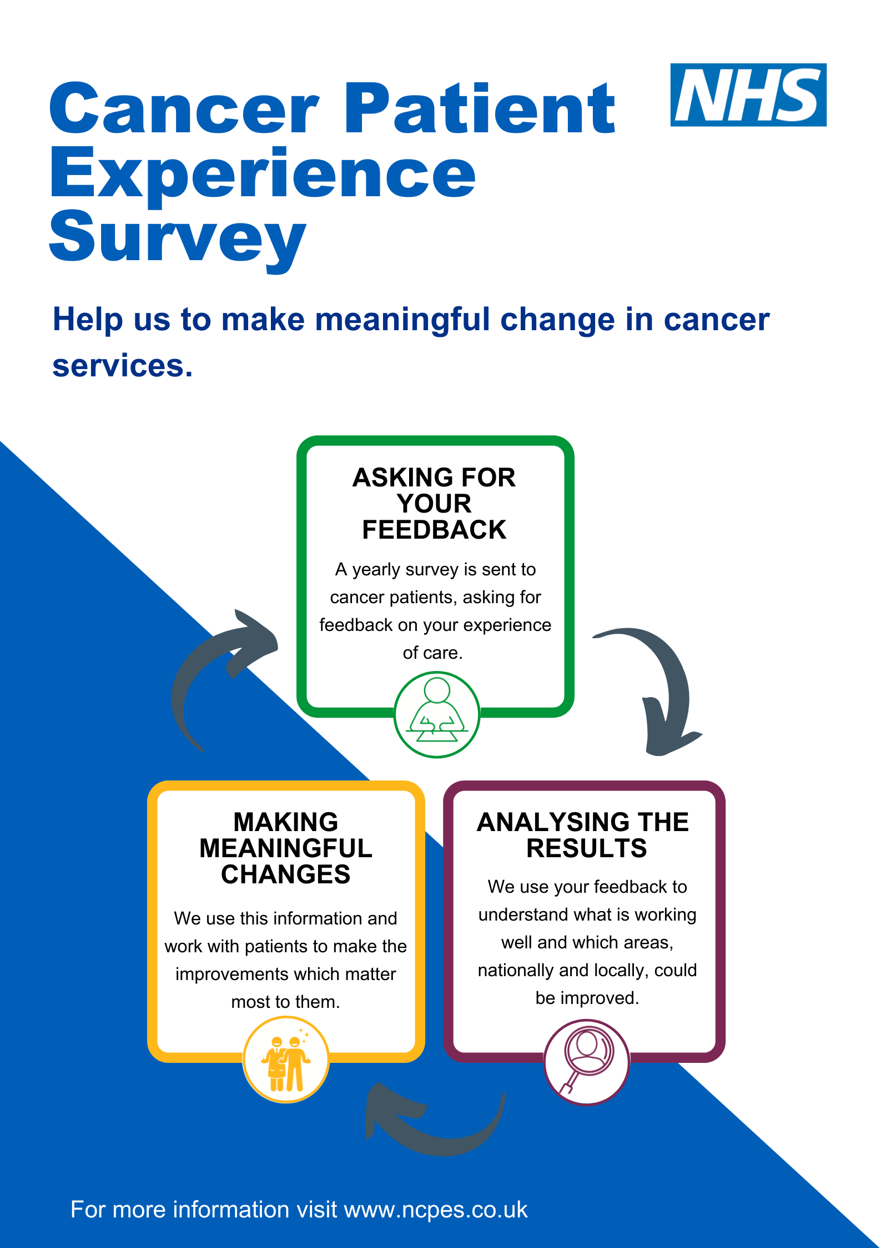
POSTERS
Please consider displaying these posters in areas that are visible to people affected by cancer and their friends or family.
Downloads of these assets can be found here.

Slide 17
FAQs
Q. What is the purpose of the survey?
A. The purpose of collecting and analysing data via this survey is to:
To measure continuous improvement and enable local systems to assess their performance improvement with other providers and commissioners.
Provide NHS England with an up-to-date overview of cancer patient experience across England.
Q. Who is running the survey?
A. Picker Institute Europe is carrying out the survey on behalf of NHS England. For more information on Picker, visit www.picker.org.
Q. How can I find out more about the survey?
A. You can find more information about the survey, including previous survey results, at www.ncpes.co.uk.
Q. When will survey results be available?
A. Reports will be available in Summer 2024 at www.ncpes.co.uk.
Q. Who will be included in the survey/ Who has received a questionnaire?
A. The survey will cover all acute and specialist NHS trusts in England that provide adult acute cancer services. The survey will include all adult patients (aged 16 and over), with a primary diagnosis of cancer, who have been admitted to hospital as inpatients for cancer related treatment, or who were seen as day case patients for cancer related treatment and have been discharged between 1 April 2023 and 30 June 2023.
Q. I have received a questionnaire but need help completing it
A. There is a freephone helpline number: 0800 103 2804 for the survey where you can get help completing it or to request translation services to complete the questionnaire. Information is also available on the back of the cover letter that was sent to you with the questionnaire, and online at www.ncpes.co.uk/faq/
Q. Why can’t I (patient) take part in the survey?
A. The survey is only offered to adult patients (aged 16 and over) with a confirmed diagnosis of cancer who have been admitted to hospital as inpatients for cancer related treatment, or who were seen as day case patient for cancer related treatment and have been discharged between the months of April, May or June 2023.
Patients aged 16 and under will be invited to take part in the Under 16 Cancer Patient Experience Survey, please visit www.under16cancerexperiencesurvey.co.uk
Q. Do I have to take part?
A. No, if you do not want to take part, please return the blank questionnaire. You do not need to use a stamp. If you prefer, please email Picker (cpes23@picker.org) or call the helpline number (0800 103 2804) and Picker will remove you from the current survey mailing list.
Q. I wasn't invited to take part but am interested in providing feedback as a recent cancer patient / family member / unpaid carer
A. Feedback can be provided through the Patient Advice and Liaison Service (PALS) or patient services manager for the NHS Trust where you received care. A list of relevant contacts can be found : https://www.nhs.uk/nhs-services/hospitals/what-is-pals-patient-advice-and-liaison-service/.
Specific complaints can also be made through the Trust where you received your care. Each Trust has a member of staff responsible for complaints who will try to resolve the matter with you.
If you would prefer to give anonymous feedback, you could ask staff at the hospital for information about how to give feedback using the Friends and Family Test (FFT). The FFT is designed to be a quick and easy way to give anonymous feedback that will go directly to the staff providing your care. Alternatively, you can feedback to the commissioner, which is the organisation that pays for the service or care you received. For hospital trusts and GP services, you should contact your local integrated care board (ICB).
More information about making a complaint can be found on the following websites:
https://www.england.nhs.uk/contact-us/complaint/
http://www.nhs.uk/NHSEngland/complaints-and-feedback/Pages/nhs-complaints.aspx

Slide 18
FAQs Continued
Q. How will my personal details be handled?
Picker Institute Europe (the survey provider) takes its information security responsibilities very seriously and applies various precautions to ensure your information is protected at all times from loss, theft or misuse. Security precautions include appropriate physical security of offices and controlled and limited access to computer systems. Stringent measures have been taken to ensure personal information is securely stored and seen only by the personnel directly involved in the survey. Picker has regular internal and external audits of its information security controls and working practices, and is accredited to the International Standard for Information Security, ISO 27001. NHS England’s Privacy Notice describes how it uses personal data and explains how you can contact them and invoke your rights as a data subject. NHS England will protect your information in line with the requirements of the Data Protection Act 2018. The privacy notice can be found via https://www.england.nhs.uk/contact-us/privacy-notice/
You can obtain a copy of this by contacting the NHS England Customer Contact Centre via the details below:
Telephone: 0300 311 22 33;
Email: england.contactus@nhs.net;
Post: NHS England, PO Box 16738, Redditch, B97 9PT.
If you have any questions or concerns, please contact the NHS England Insight & Feedback team on england.insight-queries@nhs.net. If you have any questions relating to data protection, please contact the NHS England’s Data Protection Office on england.dpo@nhs.net
You have the right to make a complaint against NHS England regarding data protection issues with the Information Commissioner’s Office. For more information visit https://ico.org.uk/concerns/
Information on how Picker Institute Europe will process your information is available at https://www.picker.org/cookies-privacy/

Slide 19
Thank You
For any questions, please contact england.cancercomms@nhs.net

